Slide 1

WELCOME
TO MY PRESENTATION

Slide 2

CSE-2216
Software Development
Presentation Title
Student Management System
Presented By
Instructored By
Name : Nishan sami
ID: 11230321272
Section: 4B
Anindya Nag
Lecturer,
CSE Department , NUBTK

Slide 3
Table of Contents
NO | Topic
01 | Why a Student Management System?
02 | Core Features Overview.
03 | Student Data Management.
04 | Course Outline & Services.
05 | Responsive Design Principles.
06 | Visual Walkthrough.
07 | Benefits to Zzone Academy.

Slide 4

Zzone Academy student
Management System
Responsive Web solution Using HTML , CSS, JS

Slide 5
Why a Student Management System?
Streamlined Administration
Automates routine tasks for programming language courses, reducing manual workload and improving efficiency.
Enhanced Accuracy
Ensures up-to-date and reliable student records, fostering better communication and decision-making at zZone Academy.
Centralized Data
Consolidates essential student information: names, IDs, sections, results, and contact details in one secure location.

Slide 6




Core Features Overview
Student Profiles
Course & Services
Clear outlines and detailed descriptions of all offerings.
Full CRUD (Create, Read, Update, Delete) functionality.
About Us
Responsive Design
Showcases zZone Academy’s mission, vision, and values.
Seamless access and optimal viewing across all devices.

Slide 7
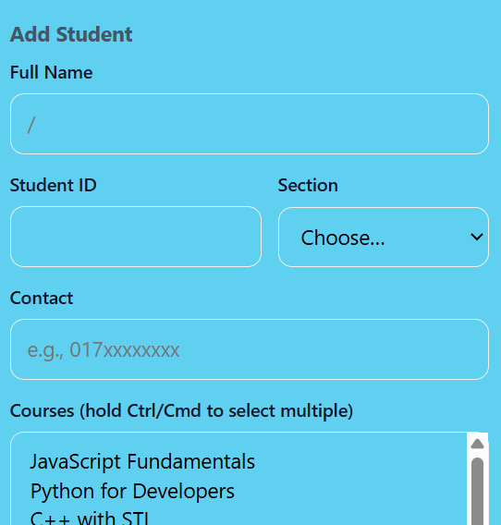
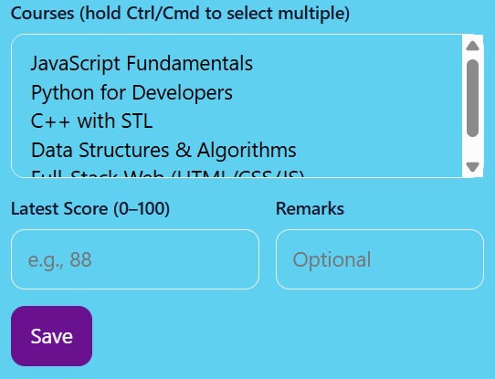
Student Data Management
Collects essential information: Name, ID, Section, Results, Course ,Contact.
Organized in a clean, easy-to-navigate table format.
Edit and delete options for quick, efficient updates.
Search functionality to find students instantly by name or ID.

Slide 8


Course Outline & Services
Detailed Course Modules
Comprehensive breakdowns of programming course modules, ensuring students understand the curriculum progression.
Comprehensive Service Offerings
From intensive training to one-on-one mentorship and hands-on project support, we cover all aspects of student success.

Slide 9
Responsive Design Principles
Mobile-First Approach
Designing for smaller screens initially ensures universal usability on phones and tablets.
Flexible Layouts
Utilizing modern CSS Grid and Flexbox for adaptive content arrangement.
Adaptive Navigation
Implementing intuitive menu systems that adjust gracefully for smaller screens.
Consistent UX
Delivering a unified and smooth user experience across all devices

Slide 10
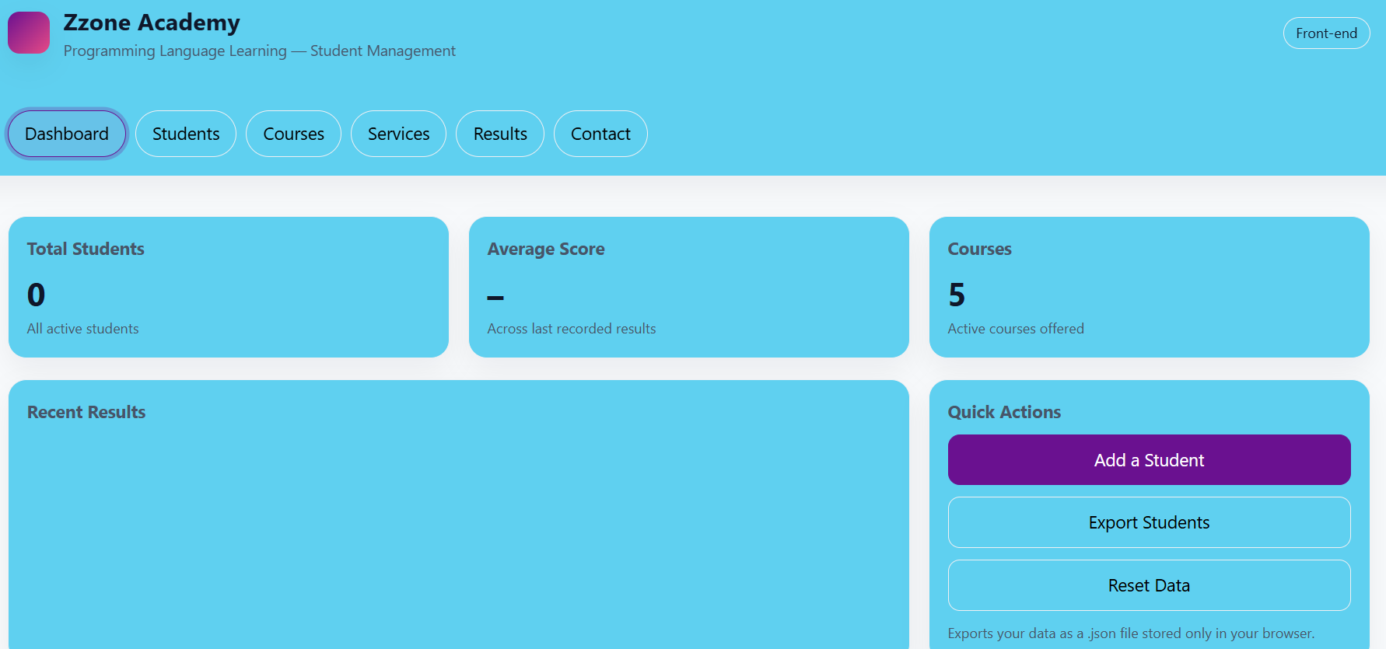
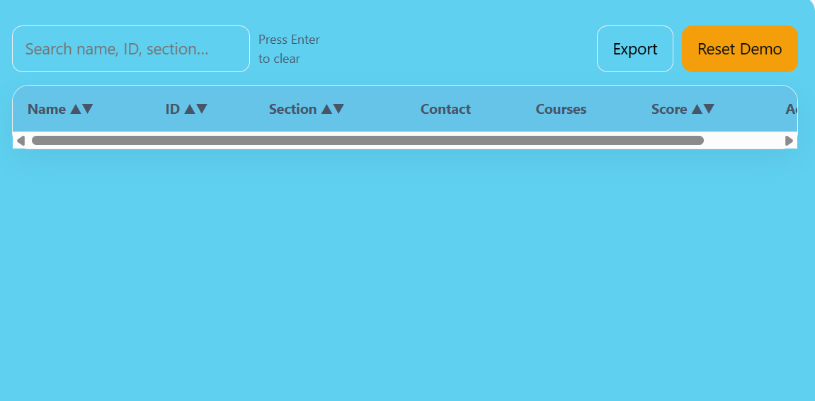
Visual Walkthrough: Homepage & Student List
Homepage Experience
Student List Interface

Slide 11

Benefits to Zzone Academy
Time Savings: Automated data handling frees up administrative hours.
Improved Accuracy: Reliable and accessible student records at your fingertips.
Enhanced Engagement: Clear course information empowers students.
Scalable Platform: Ready for future features and seamless integrations.

Slide 12
Thank You!

